Slide 1

JNTUA COLLEGE OF ENGINEERING PULIVENDULA(AUTONOMOUS)
DEPARTEMENT OF
COMPUTER SCIENCE AND ENGINEERING

Slide 2
Food Recognition and Calorie Analysis using Deep Learning Algorithms
M. Mohammed Baqar
K. Geetha
Amuru Jyothsna
Guided by
V. Kavitha
Assistant Professor(Adhoc)

Slide 3
Aim and Objectives of the Project:
Aim:
To classify the food image to predict food item name and its calorie
content using deep learning algorithms.
Objectives:
To estimate dietary calorie intake.
To prevent many health issues like heart stroke, certain types of cancer.
To help for weight loss.

Slide 4
Methodology
Food image classification is an emerging research field.
For sure, in the future automated food recognition tools will help in developing diet monitoring systems, calories estimation.
SqueezeNet and VGG-16 Convolutional Neural Networks are used for food image classification.

Slide 5
Introduction
WHO defines obesity as an "abnormal or excessive fat accumulation that may impair health“.
Causes -- genetics reason, certain medications, emotional factors like stress, less exercise and poor sleep.
We propose a model to track calorie content.

Slide 6
Summary of Literature Review
APP of deep learning in food, described in detail the proposed structure, training methods, and the final evaluation result of DNNs used to process food image, spectrum, text, and other information in each surveyed article
The class-based Bag of Textons representation in the context of food classification. The MRS4 filter banks are used to build class-based Textons vocabularies. The image representation is coupled with a Support Vector Machine for classification purpose.
Different strategies were used to construct RF ensembles, and the results compared in terms of classification accuracies and CPU time

Slide 7
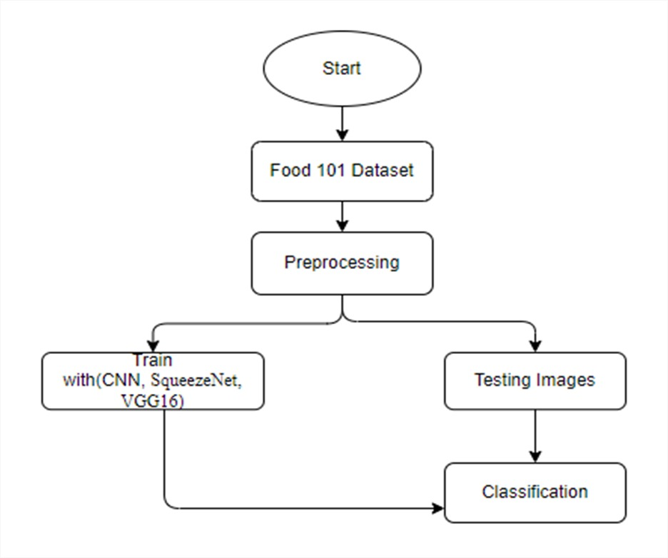
Design
Calorie Analysis

Slide 8
Solution Procedure
First, we take the Food101 Dataset
We preprocess the dataset for training
After that we split the data 70% - 30% or 80%-20% for testing process
After splitting the data, train with model CNN, SqueezeNet, VGG16
Classification of images and prediction of food item names .

Slide 9
Algorithms
CNN: CNN is a Deep Learning Architecture used for images Classification and Recognition tasks.
VGG16: VGG16 focuses on having 3*3 convolutional layers stacked on top of each other in increasing depth.
SqueezeNet: SqueezeNet is a CNN that employs design strategies to reduce the number of parameters, using 1*1 convolution.

Slide 10
Results:
In this project we have done classification of Food images :
To predict the name of the food items and
Calorie content for 100 grams using deep learning algorithms
Algorithms – CNN, SqueezeNet, VGG-16.

Slide 11
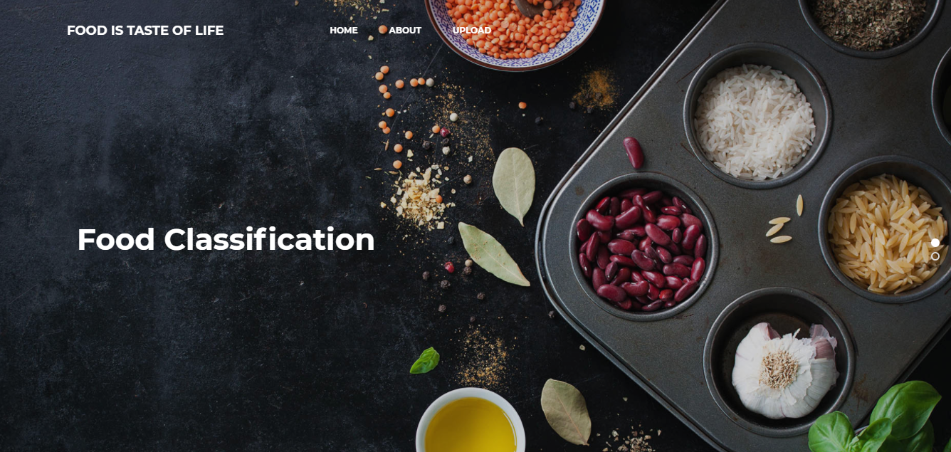
OUTPUT SCREEN SHOTS WITH DESCRIPTION
Home: Food Classification with the help of deep learning and Transfer learning.

Slide 12

About Project: Here the user will get a brief idea about the project.

Slide 13

Upload Image:
Here the images can be uploaded those which are to be classified.

Slide 14

Model choosing:
Here the model can be selected, by which the image is to be classified.

Slide 15
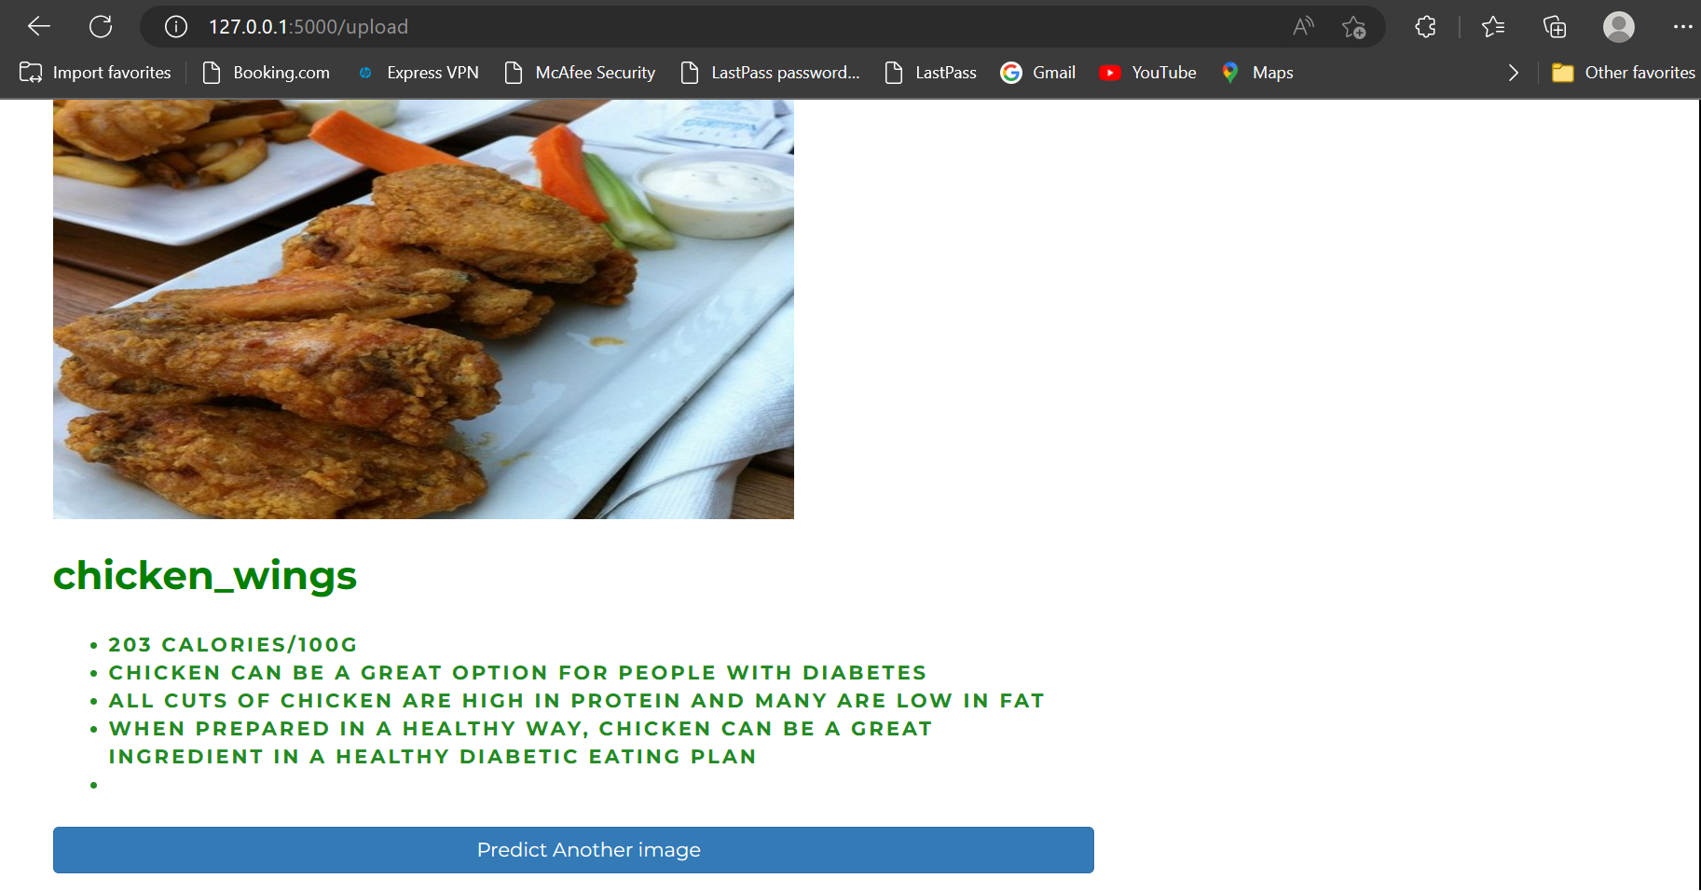
Classified output:
The uploaded image is classified to predict its name and its calorie content per 100 grams.

Slide 16
Conclusion
In this project we have successfully classified the food images using deep learning and Transfer learning.
Here, we have considered the dataset of Food101 which will be of different types of food items and trained using CNN, along with some SequeezeNet,VGG16 transfer learning methods.
After the training we have tested by uploading the image and classified it.

Slide 17
Suggestions for future work
This can be utilized in future to classify the types of different food items of larger dataset.
And an application can be developed to analyze nutritions present in food images.

Slide 18
References
Zhou, L., Zhang, C., Liu, F., Qiu, Z., & He, Y, “Application of Deep Learning in Food: A Review,” Comprehensive Reviews in Food Science and Food Safety, vol. 18, pp. 1793-1811, 2019.
Farinella, G. M., Moltisanti, M., & Battiato, S., “Classifying food images represented as Bag of Textons,” IEEE International Conference on Image Processing (ICIP), Paris, pp. 5212-5216, doi: 10.1109/ICIP.2014.7026055, 2014.
Zhou, B., Lapedriza, A., Xiao, J., Torralba, A., & Oliva, A., “Learning deep features for scene recognition using places database,” Proceedings of the 27th International Conference on Neural Information Processing Systems, vol. 1, pp. 487-495, ACM, 2014.
Rahmani, G. A.,“Efficient Combination of Texture and Color Features in a New Spectral Clustering Method for PolSAR ImageSegmentation/National Academy Science Letters, vol. 40, pp. 117-120, 2017, https://doi.org/10.1007/s40009-016-0513-6.

Slide 19


